Slide 1
Transl8
Text to translate. A smart, smart-phoneless solution.

Slide 2
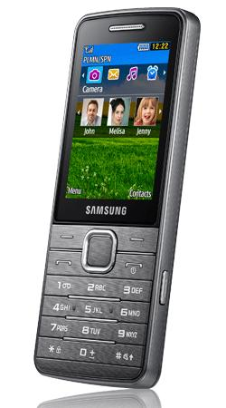
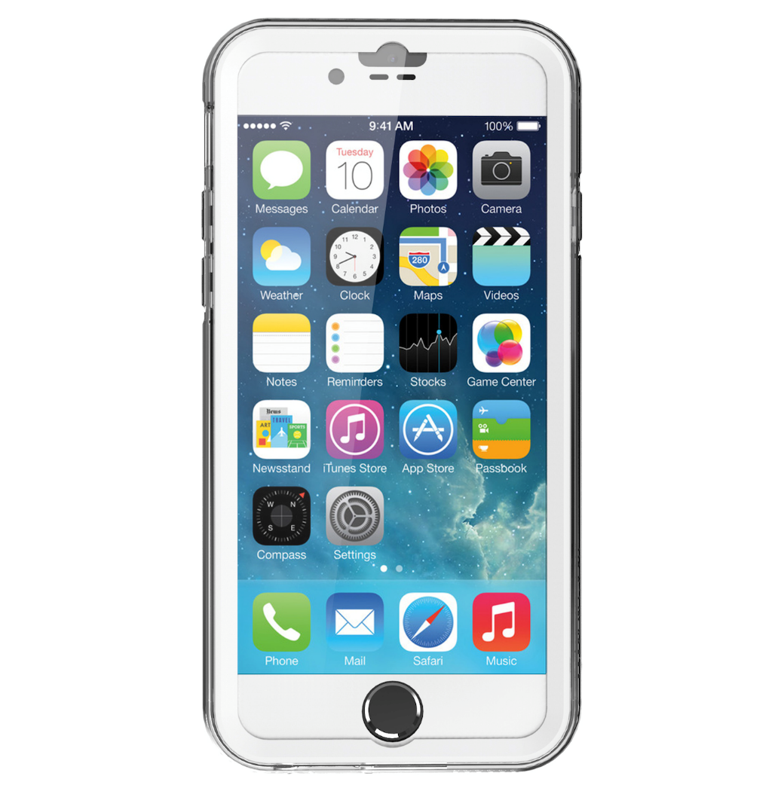


The Problem

Slide 3


Slide 4


Our Solution

Slide 5




The Product
Send a text,
interacts with Tropo
Tropo interacts with
Yandex
- Text is sent back

Slide 6
(Screenshots here)

Slide 7

Selling Data
Travelers Abroad
Big
Business

Slide 8


THE FUTURE!!!!!!!!!!!!!

Slide 9
Enhanced Language Support
Dual Sided Translations
Dictionaries

Slide 10
Serving a larger purpose
Limitations
SMS?

Slide 11



The Impact
Distributing access
Decreasing wealth gap

Slide 12
THANK YOU!

